Slide 1
Silhouette Tests
Updated 6/1/2018 by Brandon Massoni

Slide 2
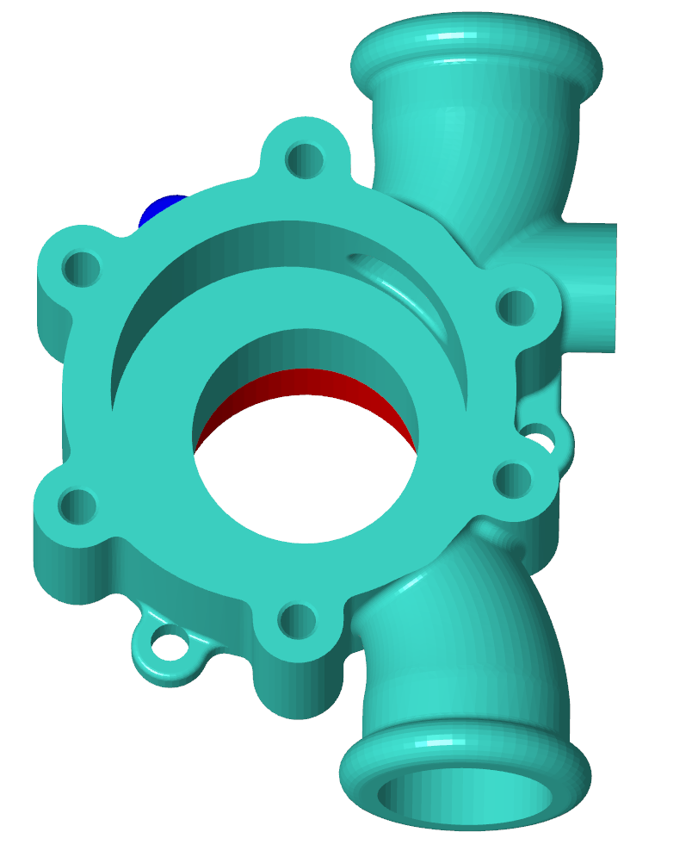
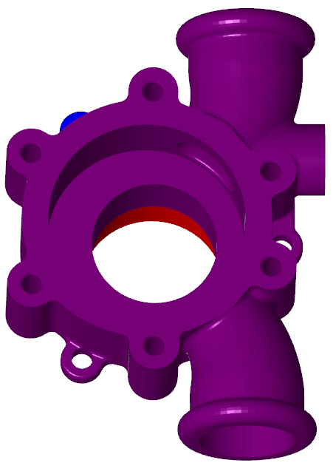
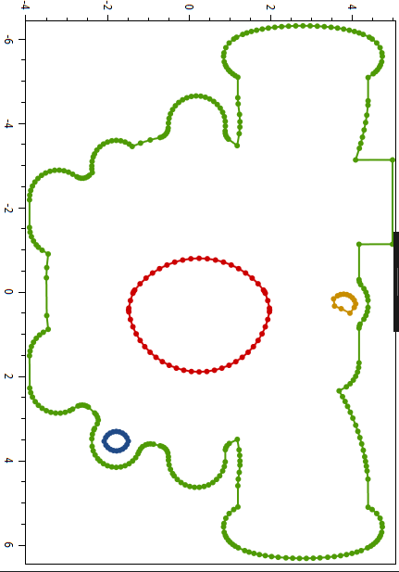
Casing, minAngle = 0.1, Normal = [0.2, 0.0, 0.8]

Slide 3
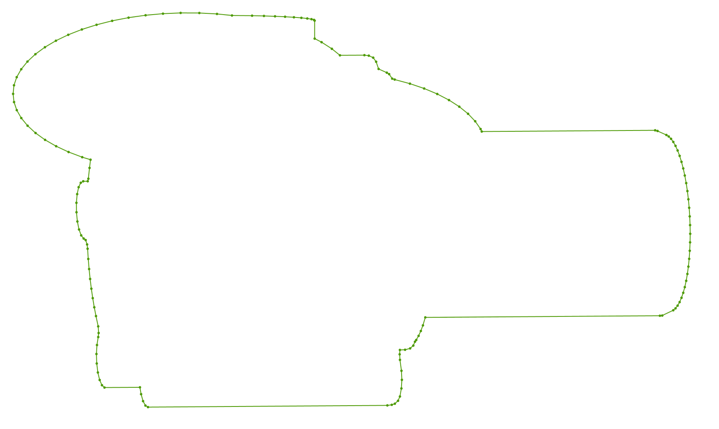
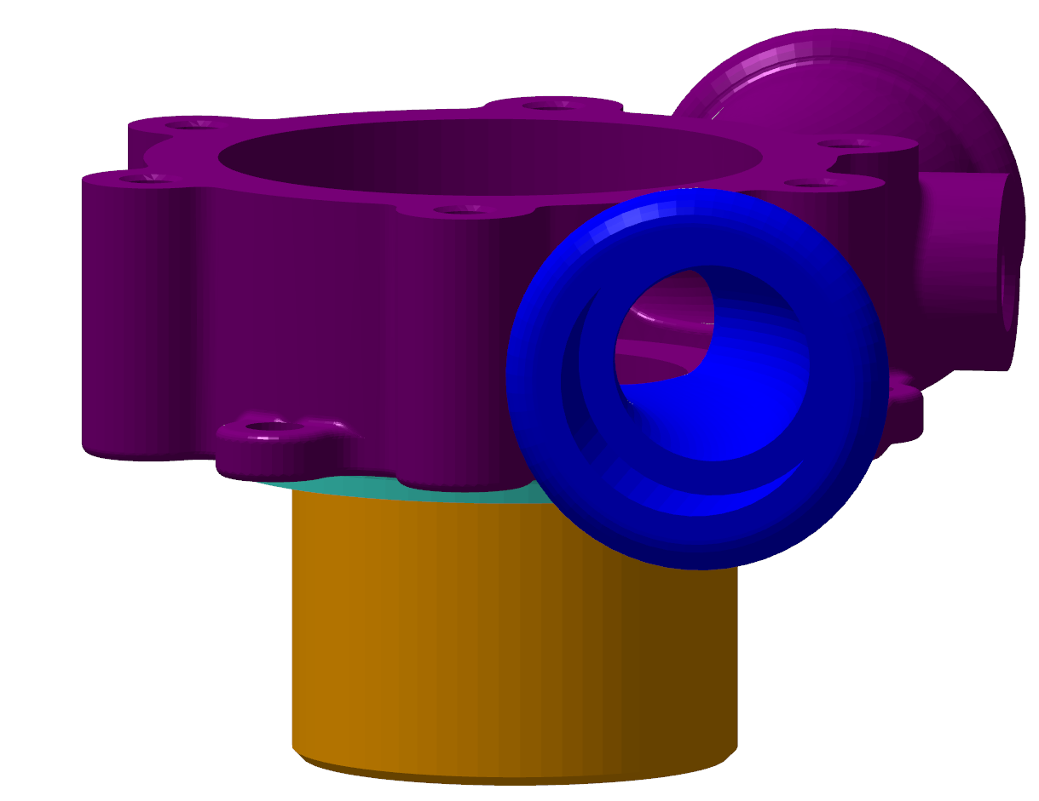
Casing, MinAngle = 0.1, Normal = { 0.8, 0.1, 0.1 }

Slide 4
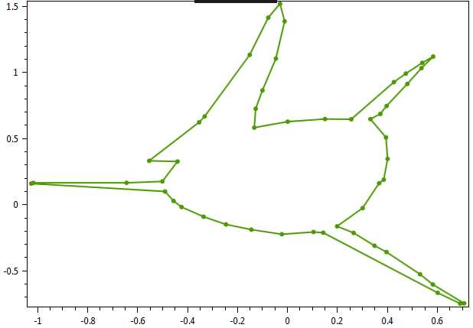
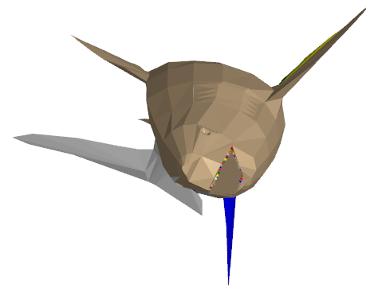
[0.2, 0.0, 0.8]

Slide 5
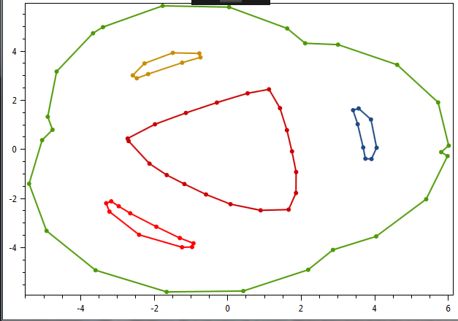
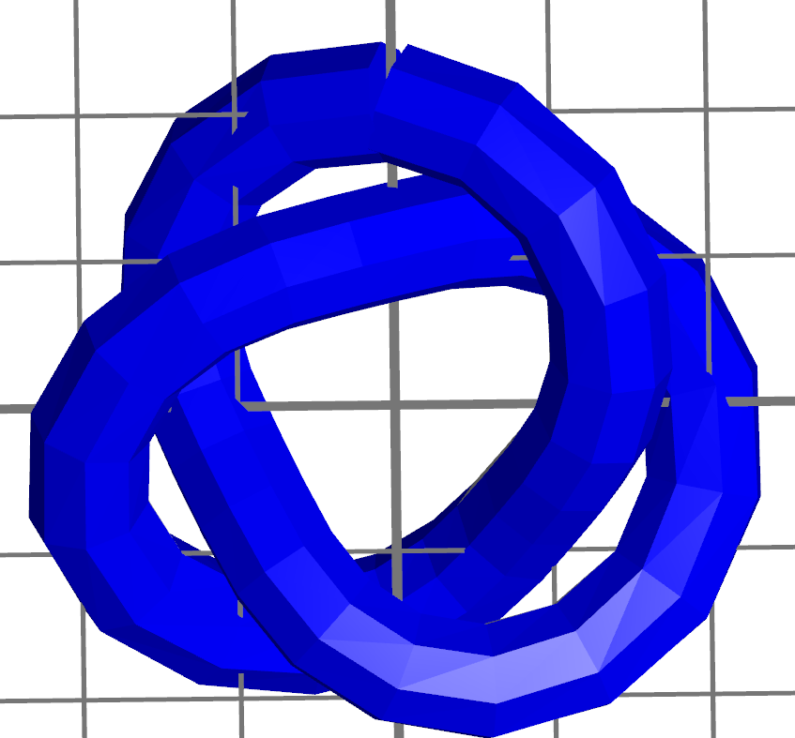
Tref, minAngle =0.1, Normal = [0.2, 0.0, 0.8]

Slide 6
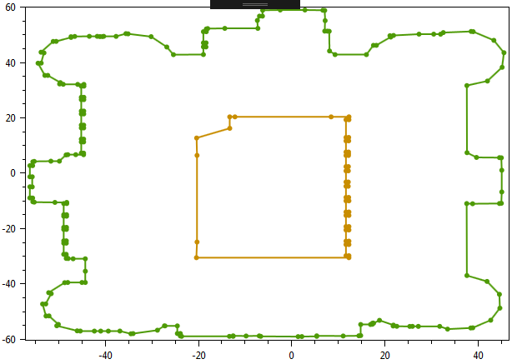
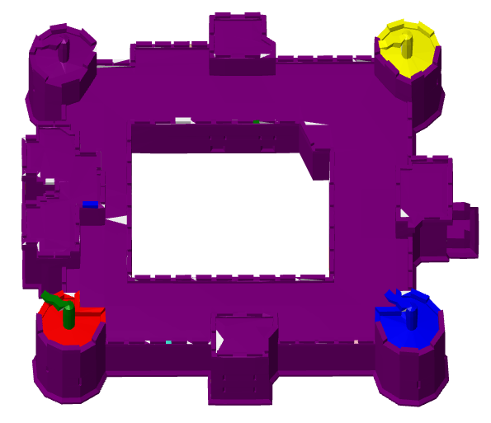
Castle, minAngle = 0.1, Normal = [0.2, 0.0, 0.8]

Slide 7
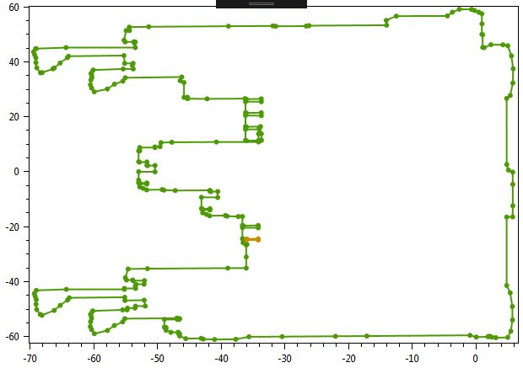
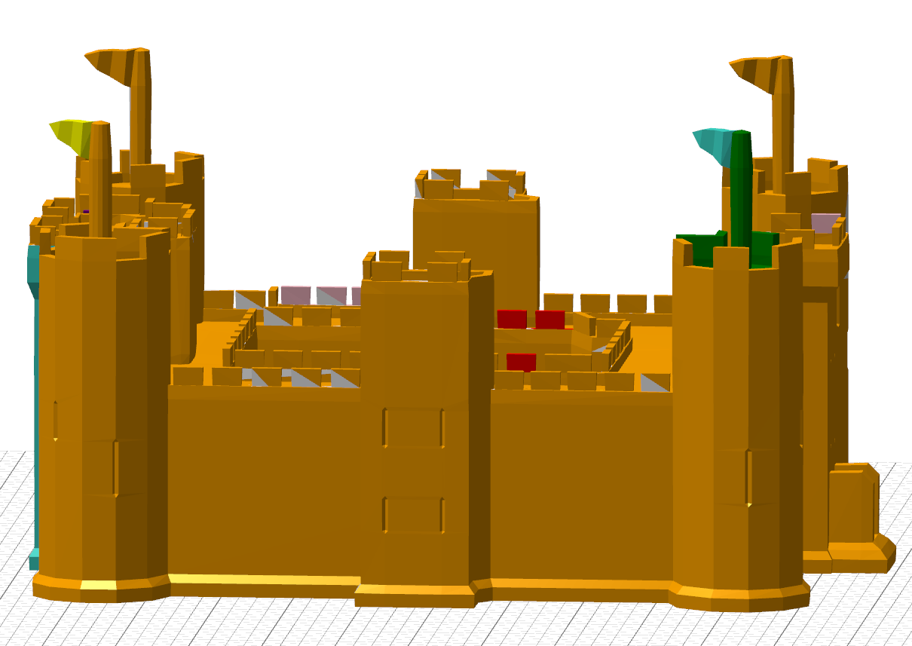

Slide 8
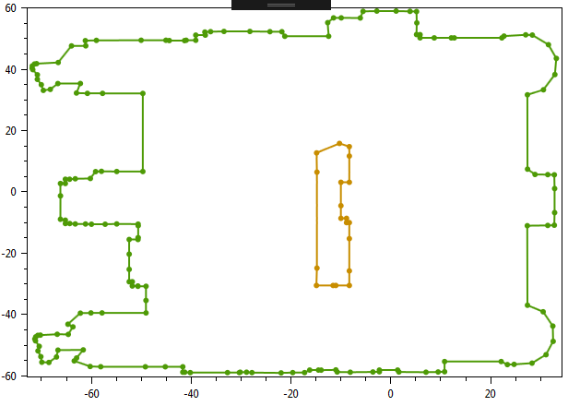
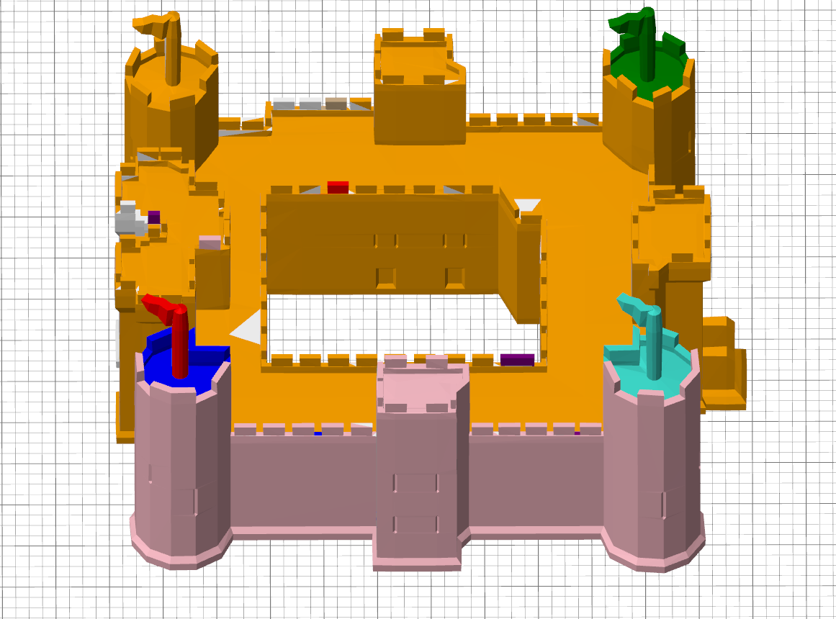
[0.5, 0.0, 0.5]

Slide 9
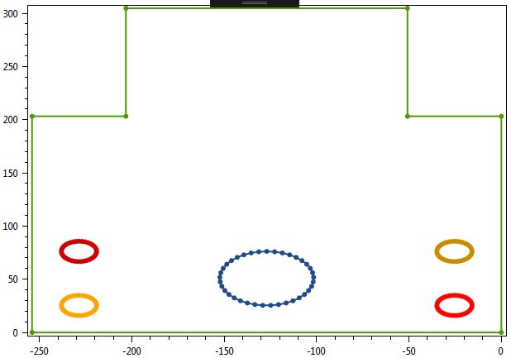
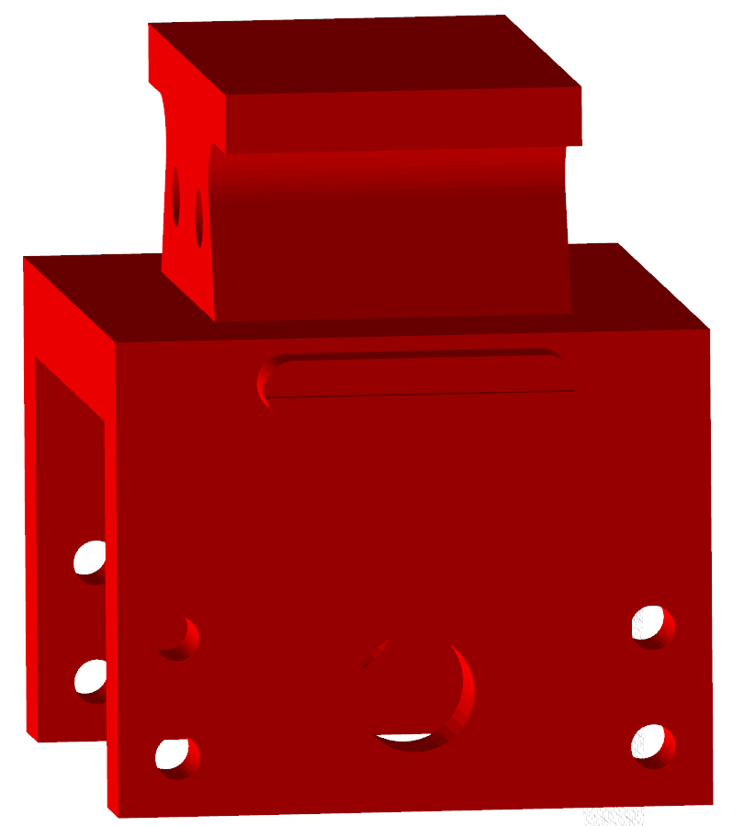
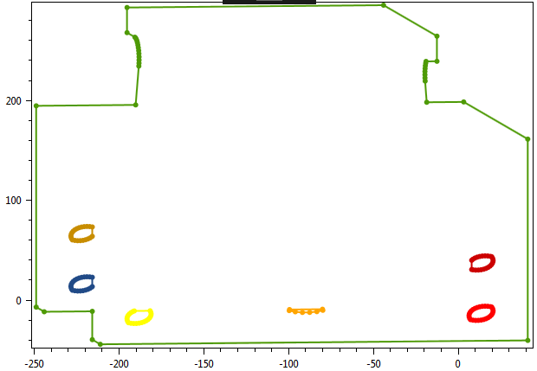
Normal = { 1.0, 0, 0}
Perfectly overlapping holes example
Square Support, MinAngle = 0.1, Normal = { 0.8, 0.1, 0.1 }

Slide 10
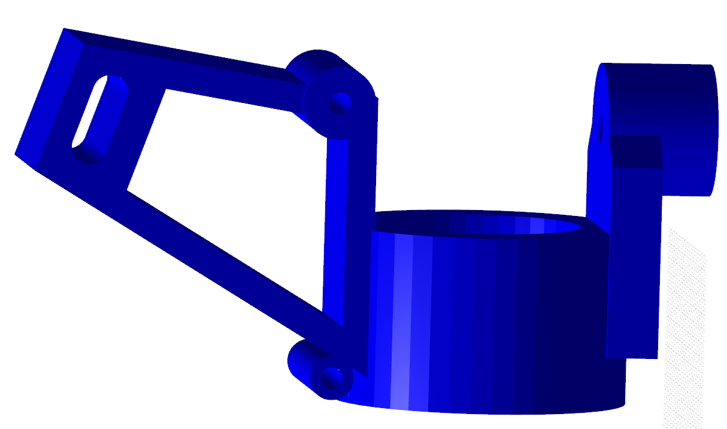
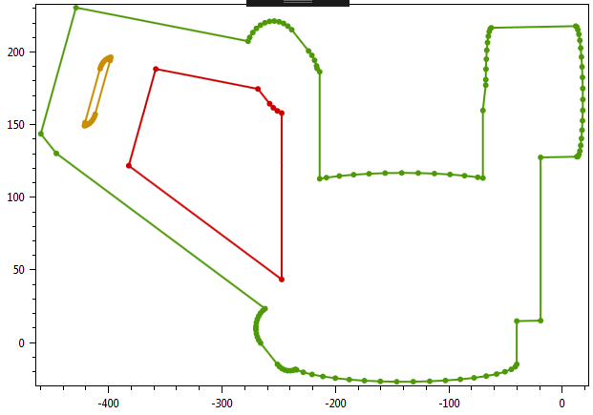
sth, MinAngle = 0.1, Normal = { 0.8, 0.1, 0.1 }

